Slide 1
Polo Insurance
Group 2
Presentation
Andrea Cole- L00115856 Cathal Keany L00115066
Conor McGinty- L00117391 Liam Whorriskey- L00113360
Eimear Mc Cann- L0010576 Maria gibson- L00105748

Slide 2
Customer Specifications Health Insurance Purposes
Online System
– Enter Customer Details.
Calculate Risk
– Produce Cost Of Insurance.
Clean
–Simple, System.

Slide 3
Take Into Account
- Unusual Personal Details
- Detailed Health Information : Smoker/Non-smoker
Travelling
- Outside Europe and the US
Administrator
- Access Detailed Information
- Edit as Appropriate
Client
-Enter Details Only

Slide 4
Requested Change
Extra Functionally - If Customer Resides In Republic Of Ireland Get Quote
- If Customer Resides In Northern Ireland No Quote Given
Appropriate Message Relayed.
CHANGES MADE:
- Edit Tables
- Edit Website
- Edit Java Code

Slide 5
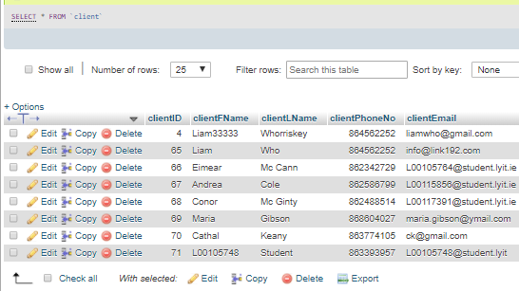
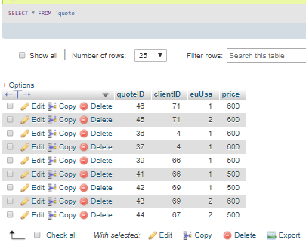
Database

Slide 6
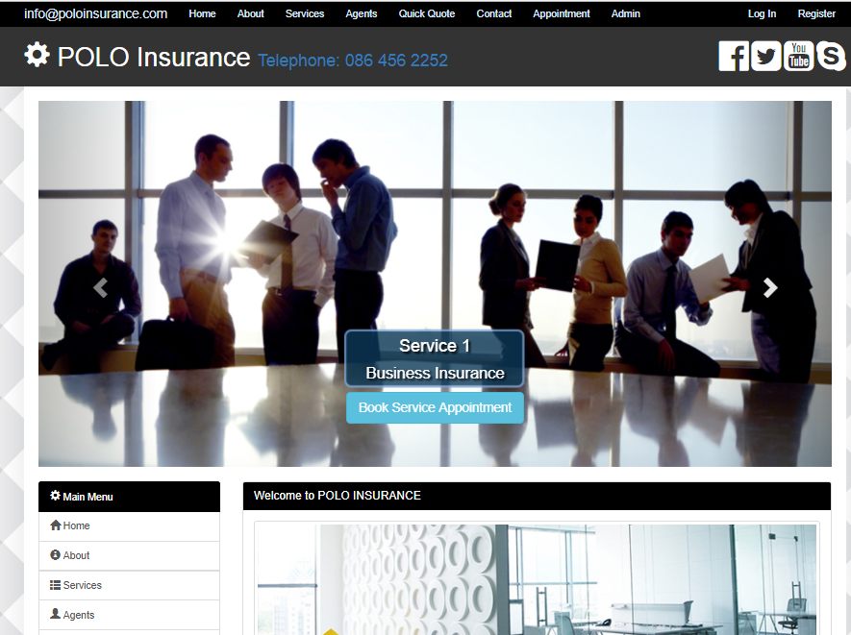
Website

